Slide 1
Unit 9: Inheritance

AP CS A
Ms. Baniqued

Slide 2
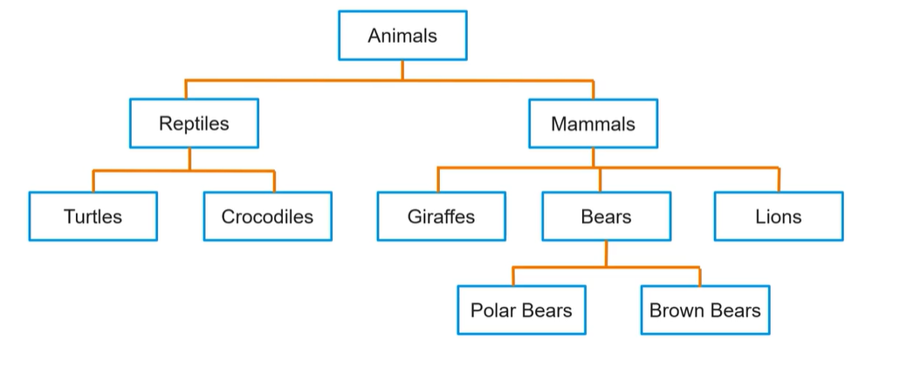
What is Inheritance?
When we think of inheritance, we think of a trait a child may receive from a parent, like eye color, athletic skills, or some other biological characteristic.
In Java, we use inheritance to build a hierarchy of classes that possess similar characteristics.
Parent classes (or superclasses) have attributes and behaviors that can be inherited by child classes (or subclasses).

Slide 3
Why use inheritance?
Code reusability – Higher level classes can be used over and over again in many situations
Prevents repeating code – Common methods and variables are now in one location, rather than many
Readability and organization – Having a solid, organized structure of your classes and objects allows for greater readability and cohesion
Ease of maintenance – Changing a general behavior in one place rather than many saves time and effort.

Slide 4
Scenario: Performers, Musicians, Comedians, Dancers, Ballet Dancers
Consider a scenario where you are designing a simulation game.
Among the many types of characters in the game, there are performers. Performers have a name, age, a hometown, and an agent.
All performers can practice and perform. There are also many different types of performers, including musicians, comedians, dancers, and ballet dancers. Each type of performer will have the common performer characteristics, but they will also have specific attributes and behaviors that relate to their individual group.
Notes:
In Performer.java, what are the fields? What are the methods?

Slide 5
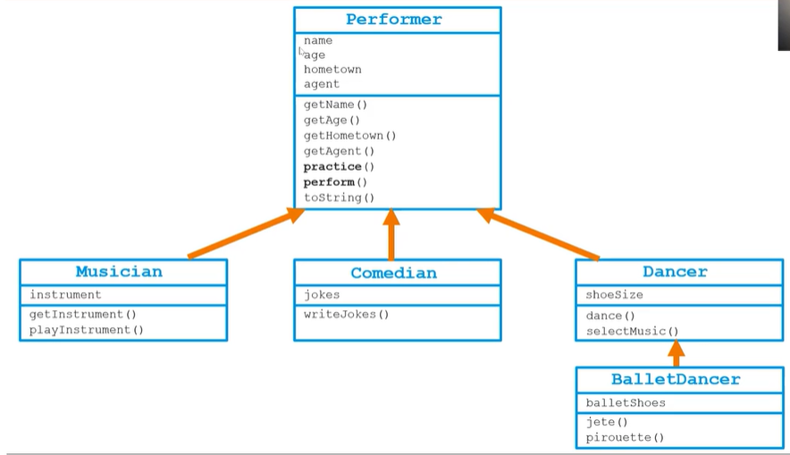
Notes:
In Performer.java, what are the fields? What are the methods?

Slide 6
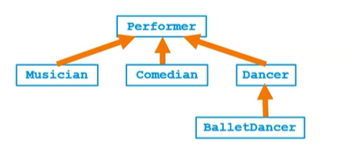
Superclasses and subclasses
Each subclass can only have one superclass. All subclasses inherit the attributes (fields) and methods of their superclasses.
Musician is a subclass of the superclass: _________________.
Comedian is a subclass of the superclass: _________________.
Dancer is a subclass of the superclass: _________________.
BalletDancer is a subclass of the superclass: _________________.
Whenever one class inherits another class, it is called an IS-A relationship.

Slide 7
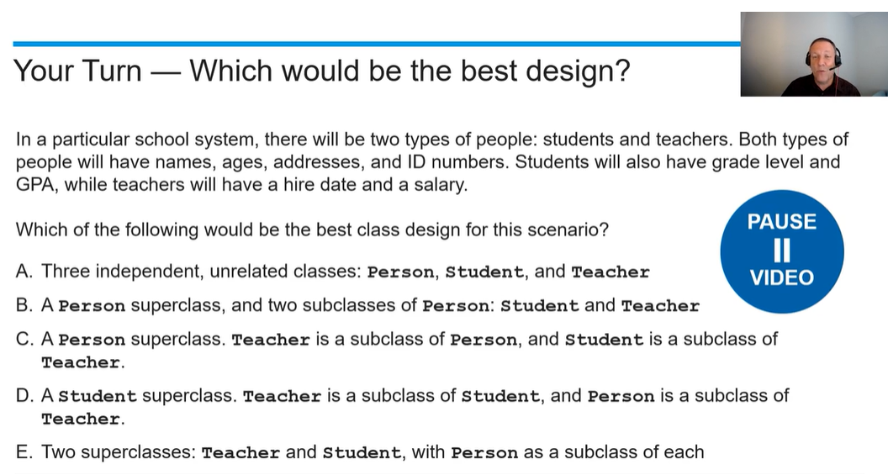

Slide 8
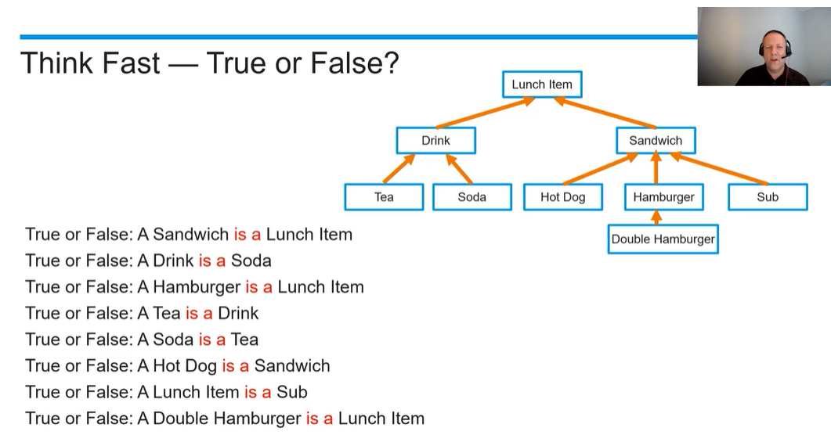

Slide 9
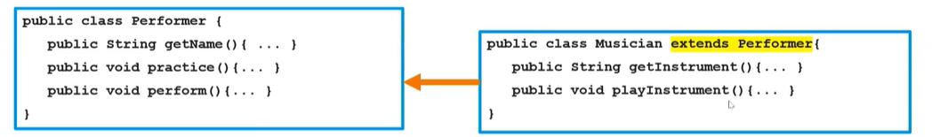
By using the extends keyword, the subclass Musician inherits all methods and fields of the superclass Performer without duplicating code.
Consider the following instances of Performer and Musician. Which method calls are valid or invalid?
Performer james = new Performer();
Musician lisa = new Musician();
lisa.getInstrument();
lisa.playInstrument();
lisa.getName();
lisa.practice();
lisa.perform();
james.getName();
james.practice();
james.perform();
james.getInstrument();
james.playInstrument();

Slide 10
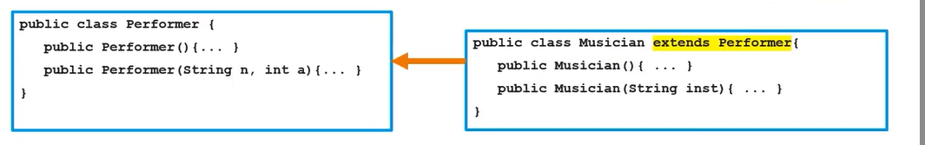

Constructors are not inherited.
Consider the following instances of Performer and Musician. Which Constructor calls are valid or invalid?
Performer james = new Performer();
Musician lisa = new Musician();
Performer james = new Performer(“James”, 19);
Musician lisa = new Musician(“Lisa”, 20);
Musician lisa = new Musician(“Saxophone”);
Performer james = new Performer(“Trumpet”);
Musician lisa = new Musician(“Lisa”, 20, “Saxophone”);
Notes:
Annotate what happens with the class as it is (implicit super() call)
What is the result of the Musician(String) constructor?
What if I want to define all the fields of a subclass in one line? (the last line on this slide). Create new constructors.

Slide 11
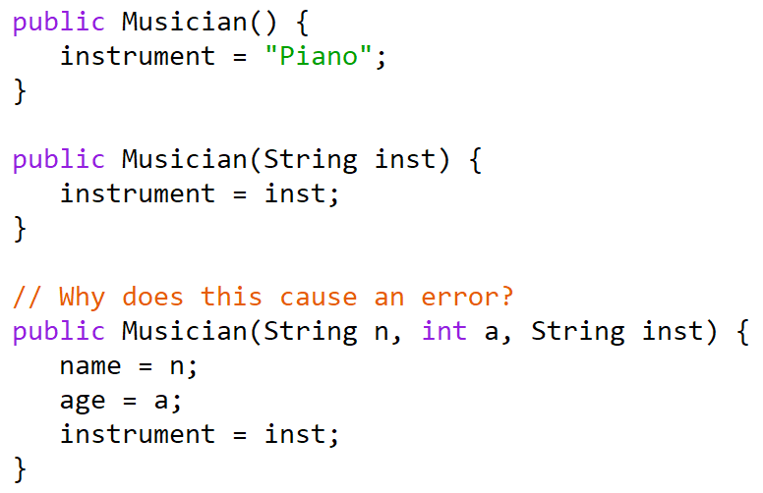
“But I thought subclasses inherit the fields of their superclass?”
Private fields are inherited, but not directly accessible.
Notes:
They are inherited, but not directly accessible.

Slide 12
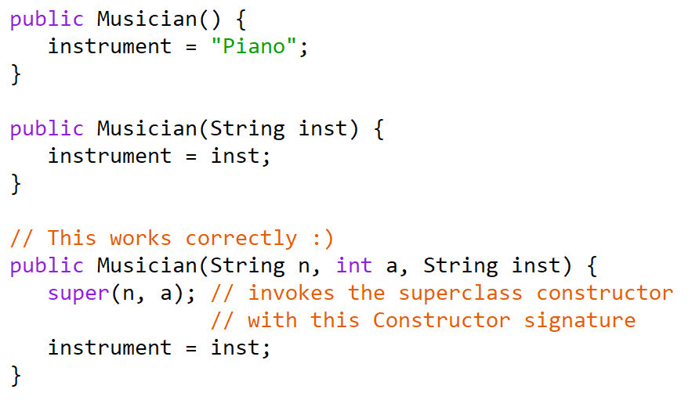
Notes:
Now let’s write Musician.java correctly AND write have you try Dancer.java on your own.

Slide 13
Notes:
Write Dancer.java and BalletDancer.java

